Slide 1
CORBA Basics
Srikanth Gunturu
Guest Faculty
BITS, WILP

Slide 2
In this segment
CORBA Overview
CORBA Introduction
CORBA Basics

Slide 3
CORBA
Evolution and History
Introduced in 1990s by Object Management Group (OMG)
Popular initially and available even today in some installations
Introduced the notion of “everything for everybody”, i.e. any language/platform talking to any other language/platform via CORBA
Gradually declined in 2000s with the explosion of Internet (WWW) and advent of firewalls
Hacking of ports was a major challenge for CORBA as time progressed

Slide 4
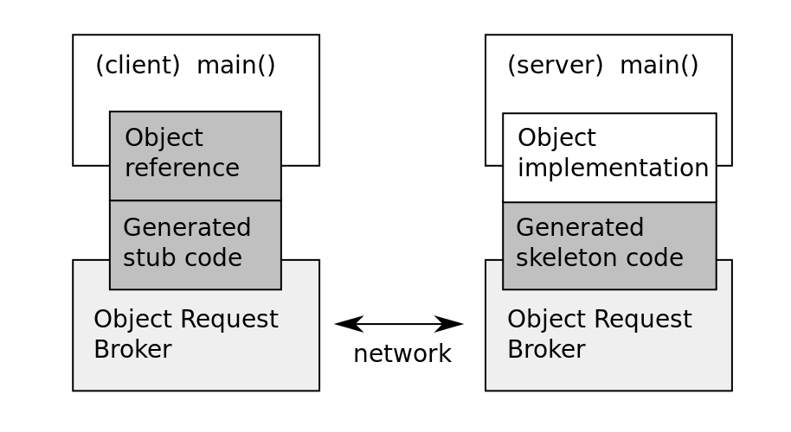
CORBA
Overview
Primarily client-server oriented
Can be seen as RPC on remotely located objects (due to distributed OO nature)
Uses General Inter-Orb Protocol (on TCP/IP) to communicate and transfer data between client and server
Client side proxy object
Represents remote object in local client space
Handles data serialization/encoding and communication with network using ORB

Slide 5
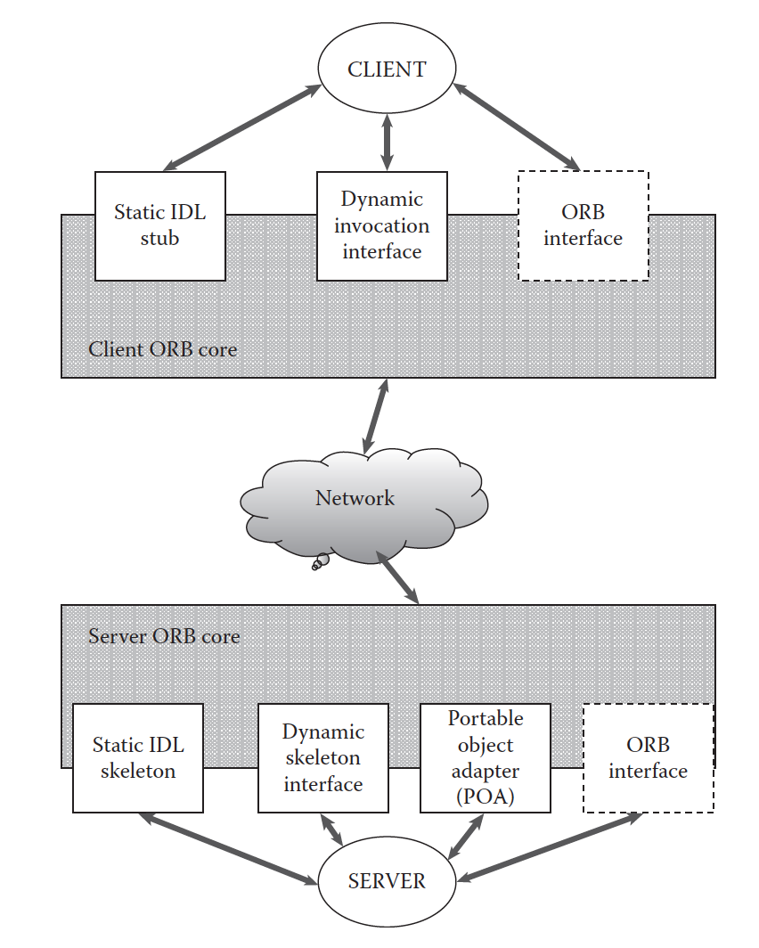
CORBA
Architecture
CORBA supports static and dynamic interfaces using Interface Description language IDL
Static interface defined at compile time using IDL compiler
Dynamic interface that defines invocation at runtime
IDL stub is client side implementation that calls CORBA library API for client operation
IDL skeleton is on server side, that uses CORBA library API for server side operation
POA (Portable Object Adapter) performs server-side functions, similar to EJB containers, Web servers etc.

Slide 6
Thank You!
In our next session:
Interface Description Language (IDL)

